Slide 1


Python –
Variables
5th Computer Science

Slide 2
Learning Intentions – 06/09/2021
Understand how to comment code
Define what a variable is
Construct a program using input command with a variable

Slide 3
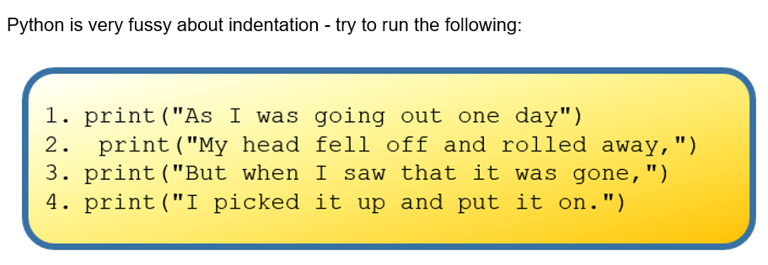
Indentation
Indentation refers to the empty space(s) at the beginning of a line of code

Slide 4
Indentation
Every line of code must be indented correctly
Proper indentation means logically related lines (blocks of code) appear at the same level of indentation

Slide 5
Commenting
Useful when your code needs further explanation. Either for your future self and anybody else.
Useful when you want to remove the code from execution but not permanently
Comments in Python are done with #
Notes:
You seen the # symbols in the slides.
I forget what I write; need to remind my future self
Programmers though it's better to write explanation in between the code
Show example

Slide 6
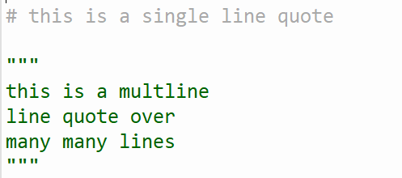
Commenting

Slide 7
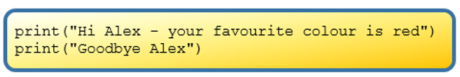
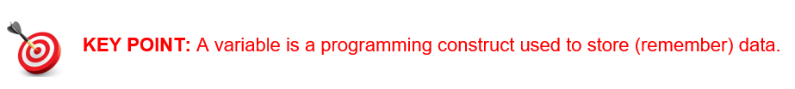
Variables
To improve this program, it would be better if we had a way of telling the program the persons name
Notes:
You seen the # symbols in the slides.
I forget what I write; need to remind my future self
Programmers though it's better to write explanation in between the code
Show example

Slide 8
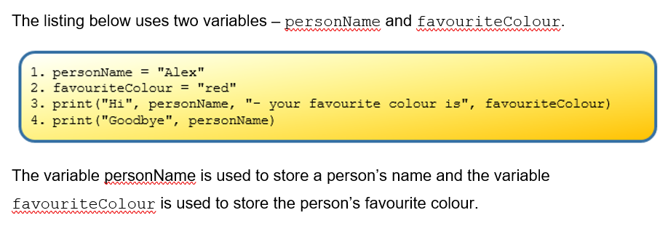
Variables
Notes:
You seen the # symbols in the slides.
I forget what I write; need to remind my future self
Programmers though it's better to write explanation in between the code
Show example

Slide 9
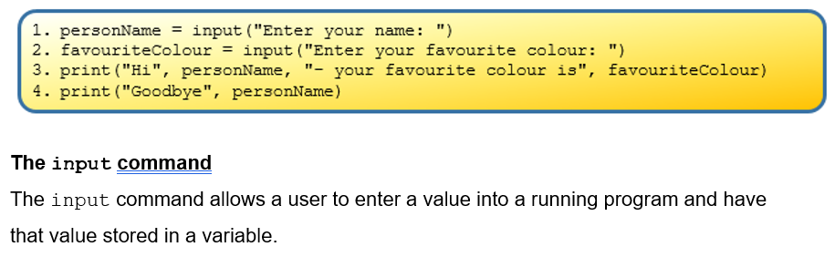
Variables - input command
Notes:
You seen the # symbols in the slides.
I forget what I write; need to remind my future self
Programmers though it's better to write explanation in between the code
Show example

Slide 10
Task 1
Write code for the following:
Create a variable to store the value of your age. Assign the value of your age to that variable and display it with the following text: “What a great age!”

Slide 11
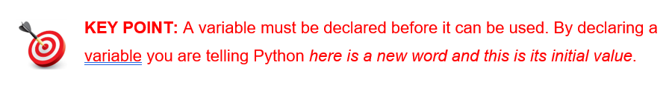
Variables
Notes:
You seen the # symbols in the slides.
I forget what I write; need to remind my future self
Programmers though it's better to write explanation in between the code
Show example

Slide 12
Variables - how to declare a variable
<variable-name> = <expression>
The ‘=‘ symbol in the middle is the Python assignment operator
personName = “Alex”
personAge = 17
yearlyIncome = 1000 * 52
personHeight = input(“What is your height in cm?)
Notes:
You seen the # symbols in the slides.
I forget what I write; need to remind my future self
Programmers though it's better to write explanation in between the code
Show example

Slide 13
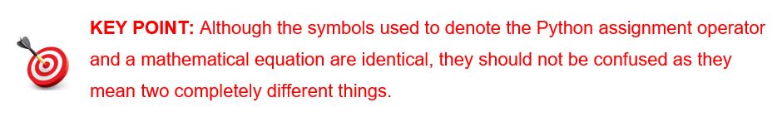
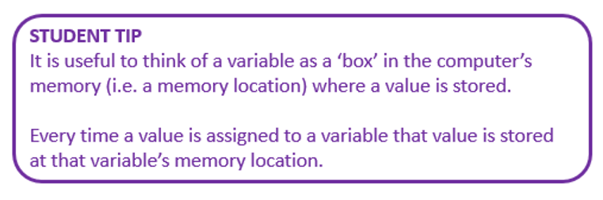
Variables
Complete task 2 in handout
Notes:
You seen the # symbols in the slides.
I forget what I write; need to remind my future self
Programmers though it's better to write explanation in between the code
Show example

Slide 14
Variables - Initialisation
Variables are used by programs to store data
If a value is needed at a later stage in the program use a variable to store it
When a variable is used for the 1st time, it must be given a value. This is called Initialisation
Notes:
You seen the # symbols in the slides.
I forget what I write; need to remind my future self
Programmers though it's better to write explanation in between the code
Show example

Slide 15
Guidelines for naming variables
Variable should be meaningful & simple
In multi-word variable names, we use camel case. The initial word is lower case, then subsequent words start with capital
  firstName
  addressLine1
  totalScore

Slide 16
Syntax rules for variable naming
  A variable name cannot be a word already reserved by Python (e.g. “print” “def”, etc.)
  Variable names must contain only letters, digits, and the underscore character, _.
  Variable names cannot have a digit for the first character.
  Spaces or dots are not allowed in a variable name

Slide 17
Python Keywords
These are words that Python uses for particular purposes. Do not use a keyword as a variable name
False
None
True
and
as
break
class
continue
def
else
elif
finally
for
from
global
if
Is
not
or
while

Slide 18
Variable names – are they correct?
aVariable
27_item
class-7
moreAt
a Variable
more@
grade_7
Item27
while

Slide 19
Types of variables used in Python
Variable Type | Python Keyword | Description | Example
Integer | int | Whole numbers | 35
Float | float | Decimal number | 35.00
String | str | Text, collection of characters | hello
Boolean | bool | True or False | True

Slide 20
Name the variable type
Save this program as variable_type.py
x = 5
y = “pi”
z = 3.14
k = True

Slide 21
Name the variable type
print(type(x))
print(type(y))
print(type(z))
print(type(k))

Slide 22
Variable Type: Integer and Float
An integer (int) is a whole number e.g. 2, 1987, -23, 0
A float is a decimal point number e.g. 2.4, 0.06, -4.5

Slide 23
Changing a variable type in the program
x=5
print(type(x))
x = 5.0
print(type(x))

Slide 24
Converting a variable value to a float
x=float(5)
print(type(x))
print(x)
x = 5.0
print(type(x))

Slide 25
Converting from float to int
x=float(5)
print(type(x))
x = int(5.9)
print(type(x))
#print(x)

Slide 26
Converting any python variable
myInt = int(“5”)
myFloat = (float(“5.5”)
myString = str(5)
myBool = bool(“False”)

Slide 27
Converting any python variable
print(myInt)
print(myFloat)
print(myString)
print(myBool)
myBool is returned as True. When a string is converted to a Boolean, all strings return a Boolean value of True unless they are empty, in which case, they have a boolean value of false

Slide 28
Printing variables with descriptive text
x=5
y=7
z=9
print(“The answer is:” , x , y , z)

Slide 29
Calculations on variables
Operator | Symbol | Python Example | Result is
Add | + | answer = x + y
Subtract | - | answer = x - y
Multiply | * | answer = x * y
Divide | / | answer = x / y | Always a float (has a decimal point)
Floor divide | // | answer = x // y | The number before a decimal point after division. Always an integer
Modulus | % | x % y | The remainder in whole number after division
Exponent | ** | x ** y | x to the power of y

Slide 30
Task 1
Write a program that assigns two numbers with decimal points (float) and then separately displays
their sum,
difference
Product
Extend this program by asking for user input for the 2 numbers

Slide 31
Task 2
Write a program that assigns two decimal numbers and then
- calculates and displays their average,
- the remainder after division,
- the first to the power of the second
Extend this program by asking for user input for the 2 decimal numbers

Slide 32
Task 3
Write a program to calculate and display the total from the bill below
5 x mars bars @ €1 each
4 x cans of coke @ €1.50 each
3 x bags of crisps @ 80 cent each
2 x cups of tea @ €2 each
1 x slice pan @ €3.50 each
Extend this task to ask the user how many of each item they want and then display the total bill

Slide 33
Task 4
Write a program to convert Fahrenheit temperature to degrees Celsius. As for user input for the Fahrenheit temperature to convert to degrees Celsius.
Use the formula: celsius = (5/9) * (Fahrenheit – 32)
Display the answer with suitable text

Slide 34
Task 5
Design and write a program that asks for user input for the height (h) and radius (r) of a cylinder.
Calculate the volume of a cylinder using the formula:
volume = 3.14 * r ** 2 * h
Print out the volume of the cylinder with an appropriate message

